Slide 1
Autoencoders and Representations
Lecture 5

Slide 2
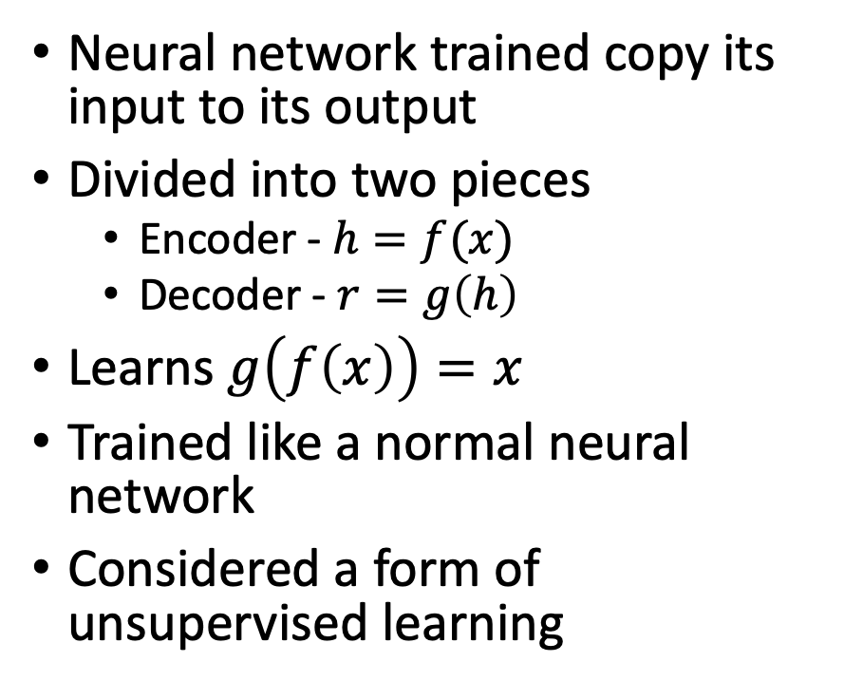
Autoencoder
Neural network trained copy its input to its output
Divided into two pieces
Encoder - $h=f(x)$
Decoder - $r=g\left(h\right)$
Learns $g\left(f\left(x\right)\right)=x$
Trained like a normal neural network
Considered a form of unsupervised learning

Slide 3
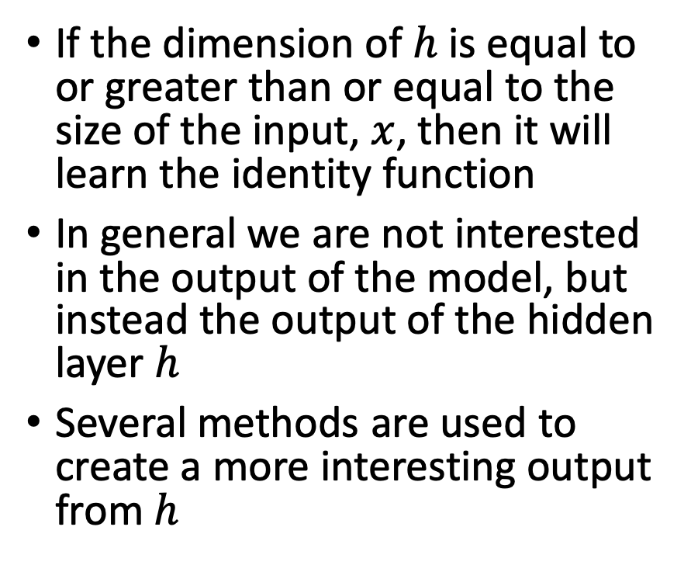
Restricting Autoencoders
If the dimension of $h$ is equal to or greater than or equal to the size of the input, $x$, then it will learn the identity function
In general we are not interested in the output of the model, but instead the output of the hidden layer $h$
Several methods are used to create a more interesting output from $h$

Slide 4

Reconstruction Error
Error “reconstructing” the input
$L\left(x, g\left(f\left(x\right)\right)\right)$
Special name for the error in autoencoders

Slide 5
Principal Component Analysis (PCA)
When the encoder and decoder a linear functions and the loss function is mean squared error
Learns the principal subspace of the data
Direction of maximal covariance
Useful method when relationships are linear

Slide 6

Undercomplete Autoencoders
Constrain $h$ to a smaller size than $x$
Process is learning $L\left(x, g\left(f\left(x\right)\right)\right)$
If $h<x$, then the autoencoder will learn a representation that contains as much information from $x$ as possible

Slide 7
Regularized Autoencoders
Autoencoders with hidden size greater than or equal to the input are possible
The size of the hidden layer is the capacity of the model
By adding regularization to the weights of the hidden layers, the hidden representations can learn interesting representations

Slide 8
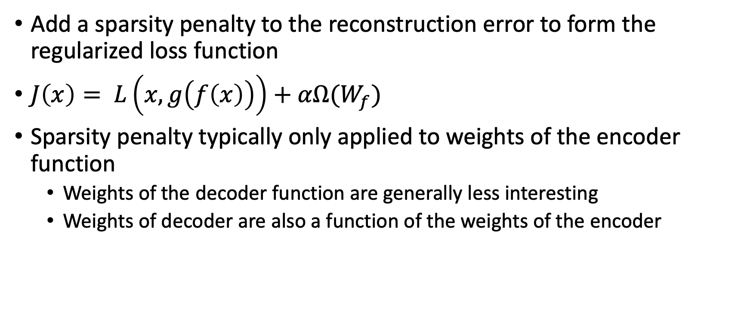
Sparse Autoencoders
Add a sparsity penalty to the reconstruction error to form the regularized loss function
$J\left(x\right)= L\left(x, g\left(f\left(x\right)\right)\right)+αΩ(W_{f})$
Sparsity penalty typically only applied to weights of the encoder function
Weights of the decoder function are generally less interesting
Weights of decoder are also a function of the weights of the encoder

Slide 9

Denoising Autoencoder
Add noise to the input, train the autoencoder to predict the “clean” input
$J\left(x\right)= L\left(x, g\left(f\left(x+ε\right)\right)\right)$

Slide 10
Brief discussion about noise
Previously, there was a question about cases where different noise distributions were more appropriate than Gaussian noise
Modeling number of days a student missed school
Many students will have 0 days off, some will have multiple
Noise distribution is different for those two different groups
Modeling the mass of a molecule
Depending on the isotopes of the atoms, different patterns of molecule weight will exist
Voxel intensity in MRI
Noise is Rician parameterized by the true intensity of that location

Slide 11
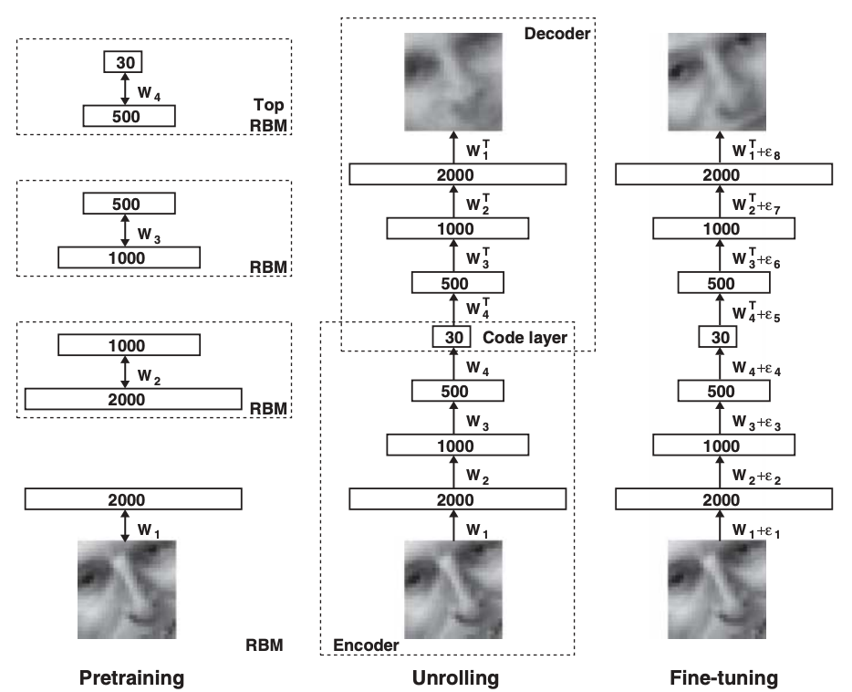
Greedy Layer-Wise Training and Stacked Autoencoders
Train one autoencoder, then train a second on the representation learned by the first, etc
”Original” deep learning paper used this technique
https://www.cs.toronto.edu/~hinton/science.pdf

Slide 12
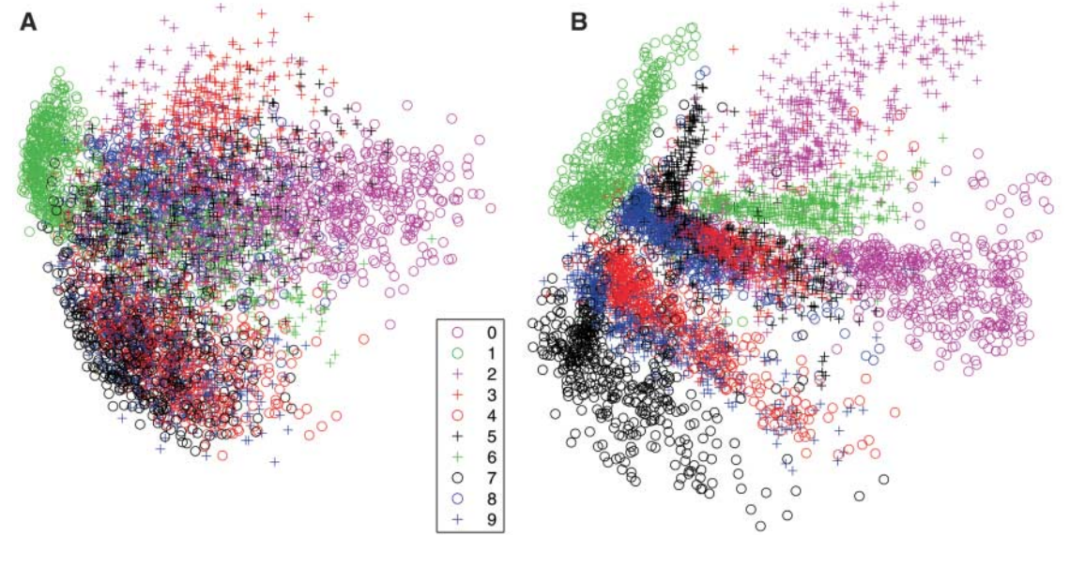
Decreasing the Dimensionality of Data with Neural Networks

Slide 13
Why Autoencoders?
In many cases the amount of true variation in some data is less than the number of input features
In images if one pixel were removed, it would be easy to guess what the value should be
Often times the amount of unlabeled data available significantly outpaces the amount of labeled data
Autoencoders do not rely on labels and can learn from unlabeled data
Training off of a smaller representation on the labeled examples may then outperform training a larger network off of just the labeled cases

Slide 14
Neural Networks as Representation Learners
The output of any layer of a neural network can be thought of as a new representation of the data
Each layer of a network transforms the data to a new representation leading to the final task
Depending on the task and constraints, the nature of each representation can change
Different loss functions product different results – cross entropy vs accuracy
Sparsity constraints
Independent features
Dropout – coexisting features

Slide 15
Examples of Representation Learning - Inception

Slide 16
Examples of Representation Learning – Word Embeddings

Slide 17
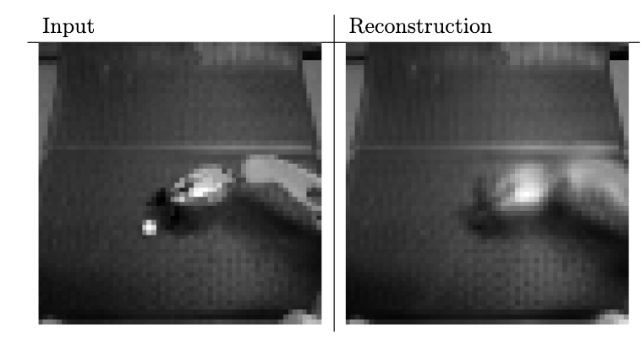
Failures of Representation Learning

